Slide 1

HEART DISEASE DIAGNOSTIC ANALYSIS
DOMAIN: HEALTHCARE
NAME: MONICA MURUGESAN
ID:UMIP0622

Slide 2

PROBLEM STATEMENT
Health is real wealth in the pandemic time we all realized the brute effects of covid-19 on all irrespective of any status. You are required to analyze this health and medical data for better future preparation.

Slide 3
STEPS
ETL: Extract- Transform and Load data from dataset.
Compare attributes of the data set to extract necessary information.
Use various visualization and features and make the best dashboard.
Find key metrics and factors and show the meaningful relationships between attributes.
Do a research from the visualization

Slide 4
DATASET DETAILS
columns | DATA TYPE | VALUES
age | int64 | 29-77
sex | int64 | 0:Female and 1:Male
cp | int64 | 1 = typical angina; 2 = atypical angina; 3 = non-anginal pain; 0 = asymptomatic
trestbps | int64 | 94-200 mm in Hg
chol | int64 | 126-564 in mg/dl
fbs | int64 | 0: False ,1:True
restecg | int64 | 0 = normal; 1 = hypertrophy; 2 = having ST-T wave abnormality
thalach | int64 | 71-202
exang | int64 | 0 = no; 1 = yes
oldpeak | float64 | 0 to 6
ca | int64 | 0 to 4
slope | int64 | 0 = downsloping; 1 = flat; 2 = upsloping
thal | int64 | 1 = fixed defect; 2 = reversable defect; 3 = normal
target | int64 | 0: less chance 1: more chance

Slide 5
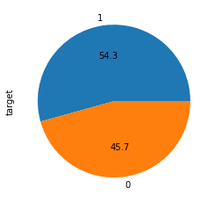
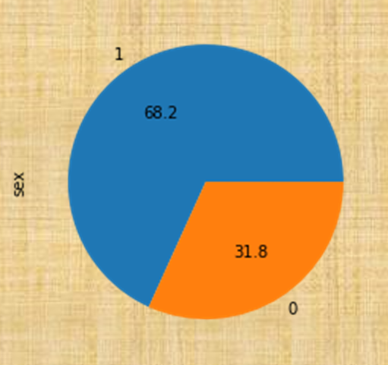

OVERALL AND GENDERWISE RISK OF HEARTDISEASE

Slide 6
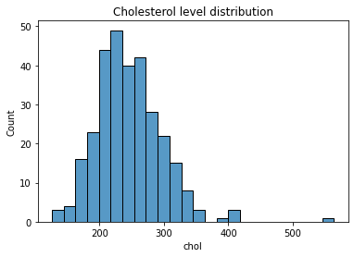
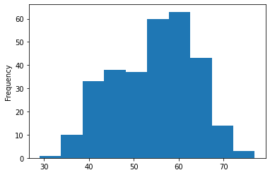
AGEWISE AND CHOLESTROL LEVEL DISTRIBUTION

Slide 7
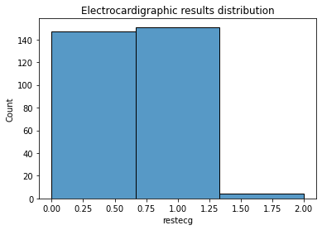
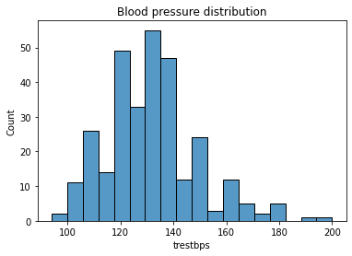
BP AND ECG DISTRIBUTION

Slide 8
CHOLESTROL LEVEL

Slide 9
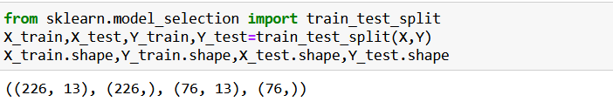
DATASET SPLIT-TRAIN AND TEST
Data is split in 75:25 ratio 75% for train and 25% for test
X_train: (226,13) and Y_train : (226,)
X_test: (76,13) and Y_test: (76,)

Slide 10
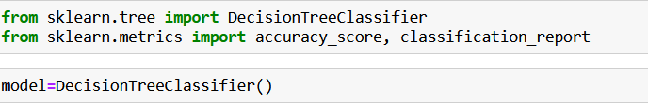
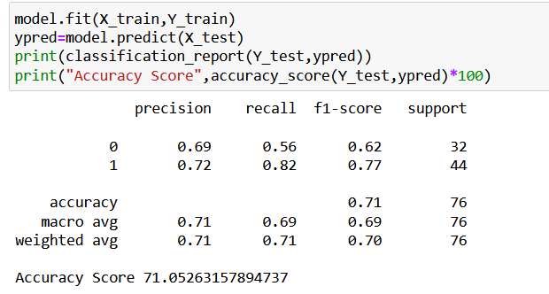
MODEL DEVELOPMENT

Slide 11
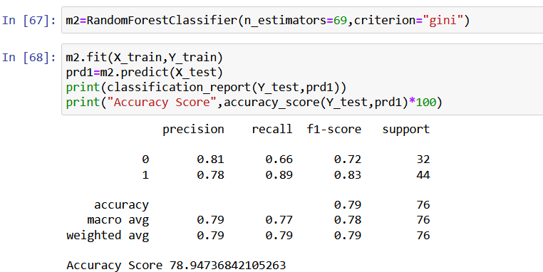
MODEL DEVELOPMENT

Slide 12
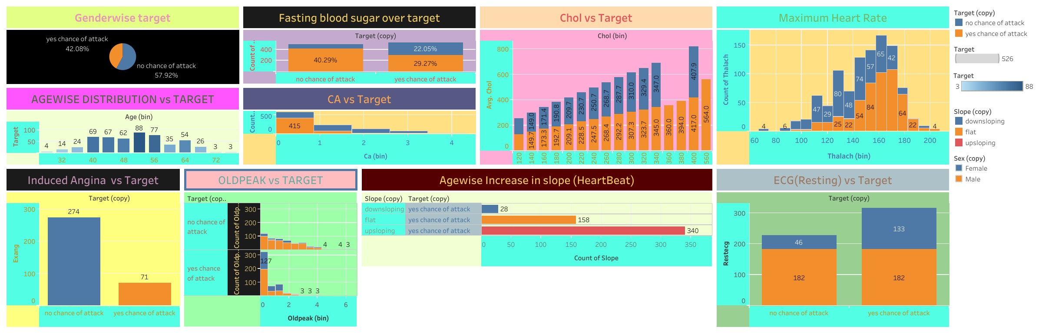
DASHBOARD

Slide 13
CONCLUSION
Male are double times likely to face heart problems than female
57-60+ range of age people are likely to face heart problems
57.5% of population are likely to have heart problems
Cholestrol level of overall population is within borderline between 200-300.
Maximum blood pressure is 150 and minimum is less than 100.
54% percent of total population are prone to risk of heart diseases remaining 45% of them have less risk of heart disease.
About 50% of the patients have hypertrophy. Only a few of the patients have ST-T wave abnormality. The rest of them have normal result

